Slide 1

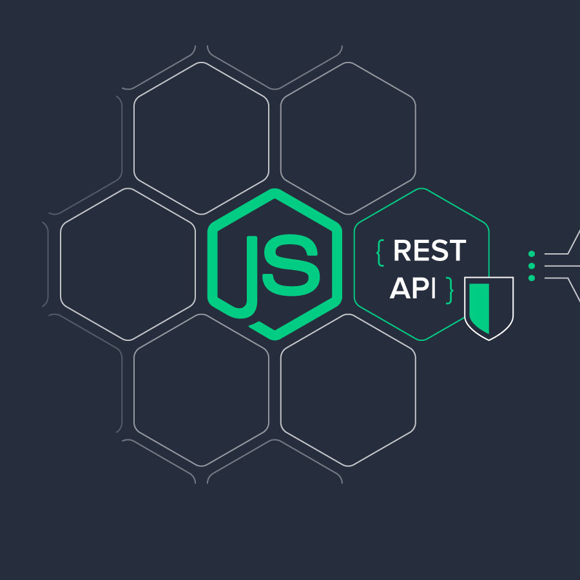
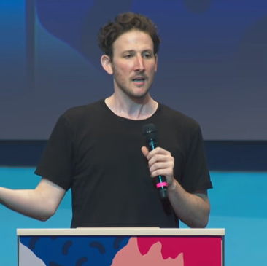

Web Application Framework
Ryan Dahl

Slide 2
Classroom Etiquette and Guidelines:
Let me know if the pace of the class is too fast.
Feel free to ask questions if you have any doubts.
Try to Answer the Question
Always arrive on time.
Do not talk while the class is in session.

Slide 3
What is Programming?
What is Programming Language?

Slide 4
What is Programming? : Writing a Program
What is Programming Language? : Is a language used to give Instruction to the Machine.

Slide 5
UNIT-I:
Introduction: Features and advantages of Node JS, Traditional Web Server Model, Node.js Process Model, Asynchronous programming with Node.js, Types of applications that can be developed using Node.js.
Setup Development Environment: Install Node.js on Windows, working in REPL, Node JS Console, Creating a Node File with JavaScript, Accessing a Node.js File Through the Command Line Interface, Using Node.js in Net- Beans IDE.

Slide 6
UNIT-II:
Node.JS Basics: Primitive Types, Object Literal, Functions, Buffer, Access Global Scope.
Node.JS Modules: Module, Module Types: Core Modules, Local Modules, Third Party Modules, Module Exports. Using Modules in a Node.js File, Using the Built in HTTP, URL, Query String Module, Creating a Custom Module.
Node Package Manager: NPM, Installing Packages Locally, Adding dependency in package.json, Installing packages globally, Updating packages.

Slide 7
UNIT-III:
Creating Web Server: Handling HTTP requests, Sending requests.
System: Reading, Writing a File, Writing a file asynchronously, Opening a file, deleting a file, Other IO Operations: Append, Rename, Truncate. File System Module with URL Module Create, Read, Remove a Directory.
Debugging Node JS Application : Core Node.js debugger, Node Inspector, Built-in debugger in IDEs

Slide 8
UNIT-IV:
Events: Event Emitter class, Methods and Events of EvenEmitter Class, Returning event emitter, Extend EventEmitter Class, Passing Arguments and ‘this’ to listeners, Asynchronous and Synchronous call, Handle Events only Once, Error Events.
Database Connectivity: Connection string, Configuring, Working with insert, select command, Updating records, Deleting records, Drop tables, Ordered Result Set

Slide 9
UNIT-V:
Express and Node JS: Introduction to Express Framework, Express Server Request-Response Routes, Route Parameters, Multiple Route Callback/Handler Functions, Methods of Response Object, Chaining Route Handlers, Send Static Files, Accept User Input, File Upload with Express, Manage Cookies, Send file as a response, Templates and Express.
RestFul API: What is REST, Install PostMan, Get all articles, Post a new article, Delete request, Make a specific Get request, put operation on a specific record, patch request, deleting a specific record.
Authentication and Security: Introduction, register and logic, encryption, cookies and session.

Slide 10
Course Objectives:
Understand Node JS and REPL terminal.
Experiment with Node JS Modules and Node Package Manager.
Develop applications to handle events in Node JS.
Make use of Web Server to manage database.
Demonstrate Express Framework.

Slide 11
Course Outcomes:
After the completion of the course, students will be able to:
CO1: Construct Node File with JavaScript, Accessing a Node.js
CO2: Explain and Develop Node JS Modules
CO3: Build Web Server
CO4: Extend Node.js to work with Database.

